Slide 1
Tic Tac Toe Game
HTML, CSS, and JavaScript Implementation

Slide 2
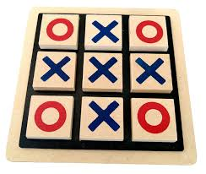
Project Overview
This project implements a simple Tic Tac Toe game using HTML, CSS, and JavaScript.
It features a 3x3 grid, interactive gameplay, player switching, and game reset functionality.

Slide 3
HTML Structure
The HTML file sets up the basic structure of the game interface:
Container with a title and status display
A 3x3 board made of div cells
Restart button to reset the game
Linked to external CSS and JavaScript files

Slide 4
CSS Styling
CSS provides styling for:
Layout with responsive design
Board grid and individual cells
Hover effects and animations
Custom styles for X and O
Gradient backgrounds and UI aesthetics

Slide 5
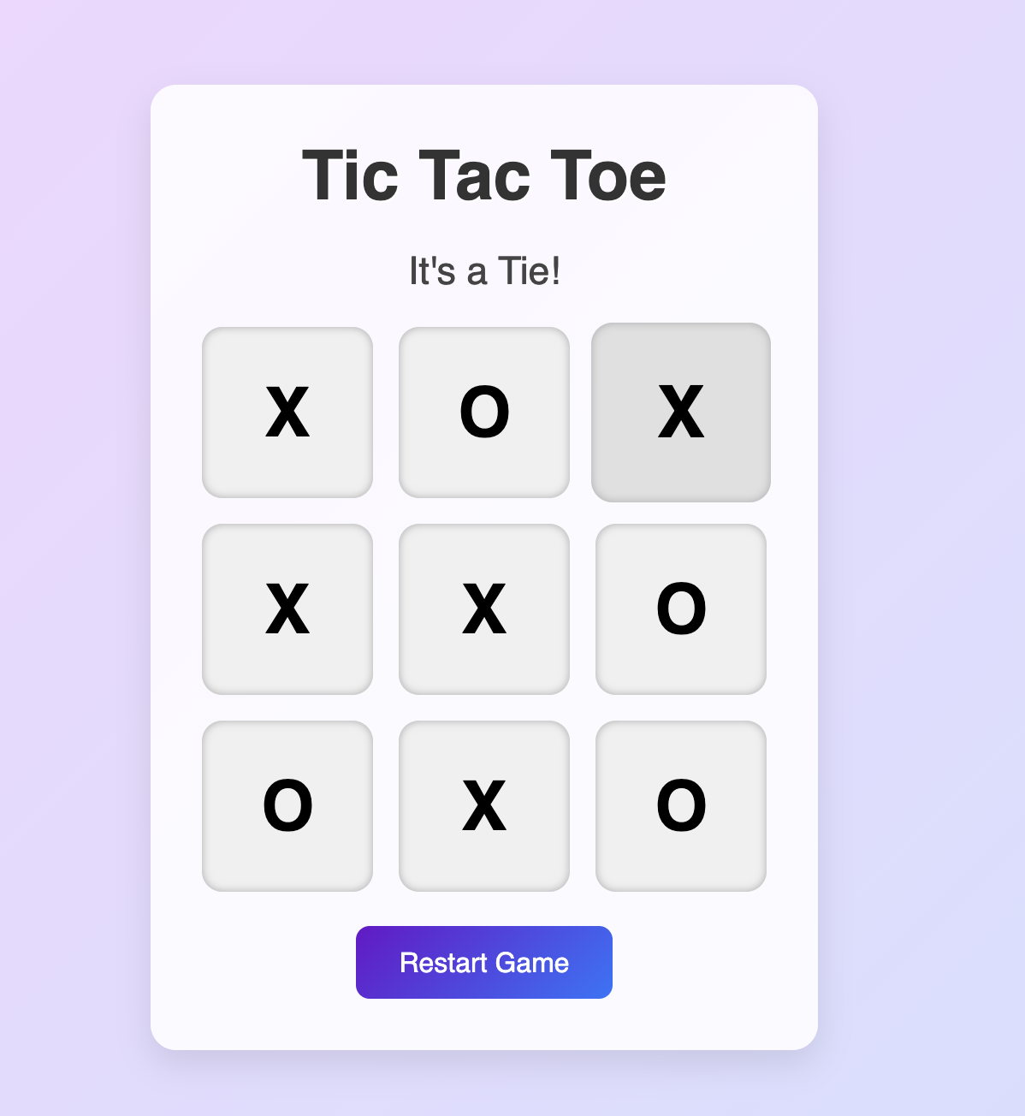
JavaScript Logic
JavaScript handles the game logic:
Tracks current player and game state
Handles cell clicks and updates board
Checks for winners or tie conditions
Resets the game board on button click

Slide 6
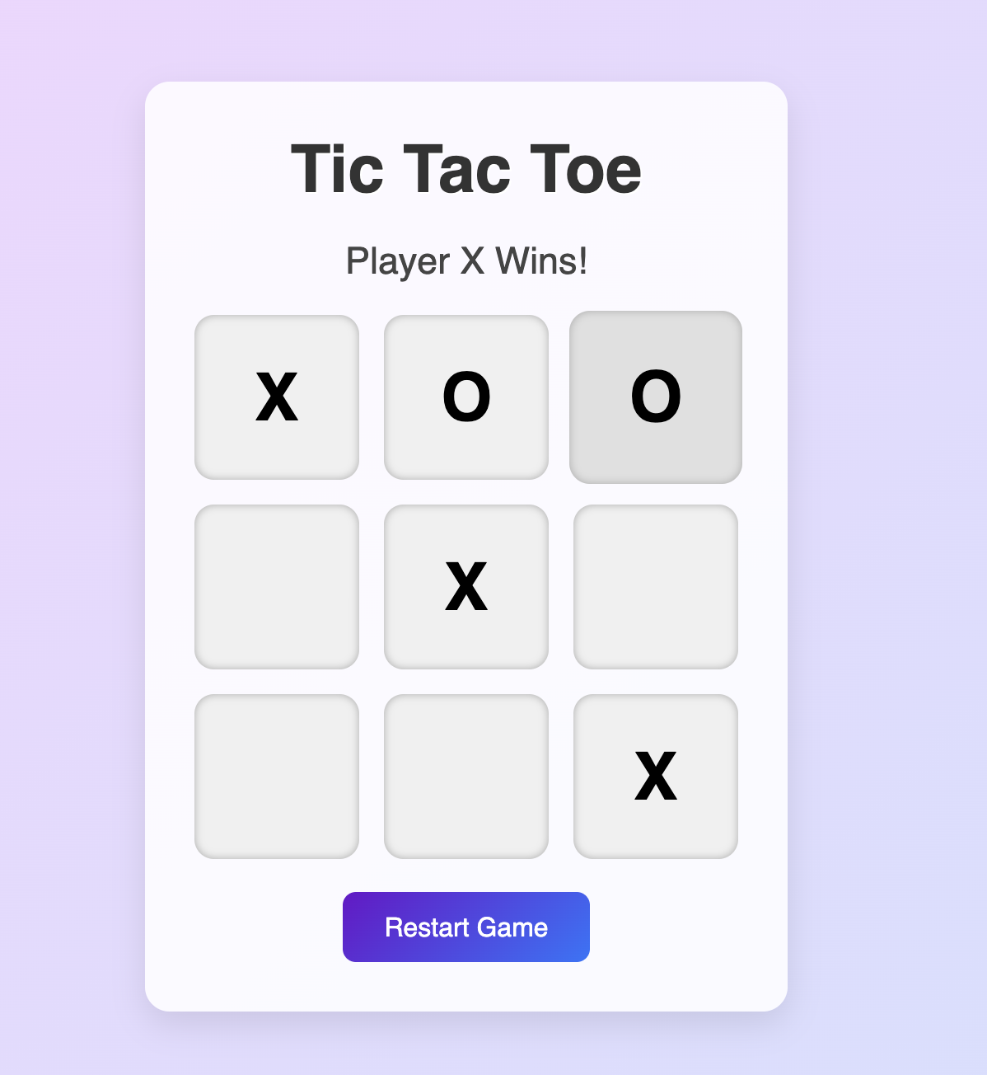
Win Conditions
Winning patterns include:
3 horizontal rows
3 vertical columns
2 diagonal
These are checked after each move.

Slide 7
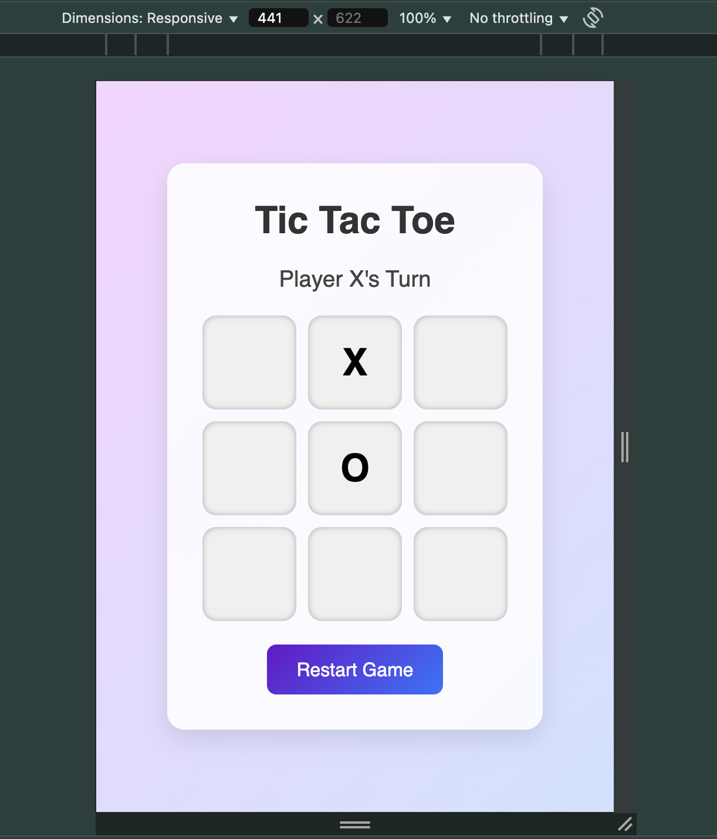
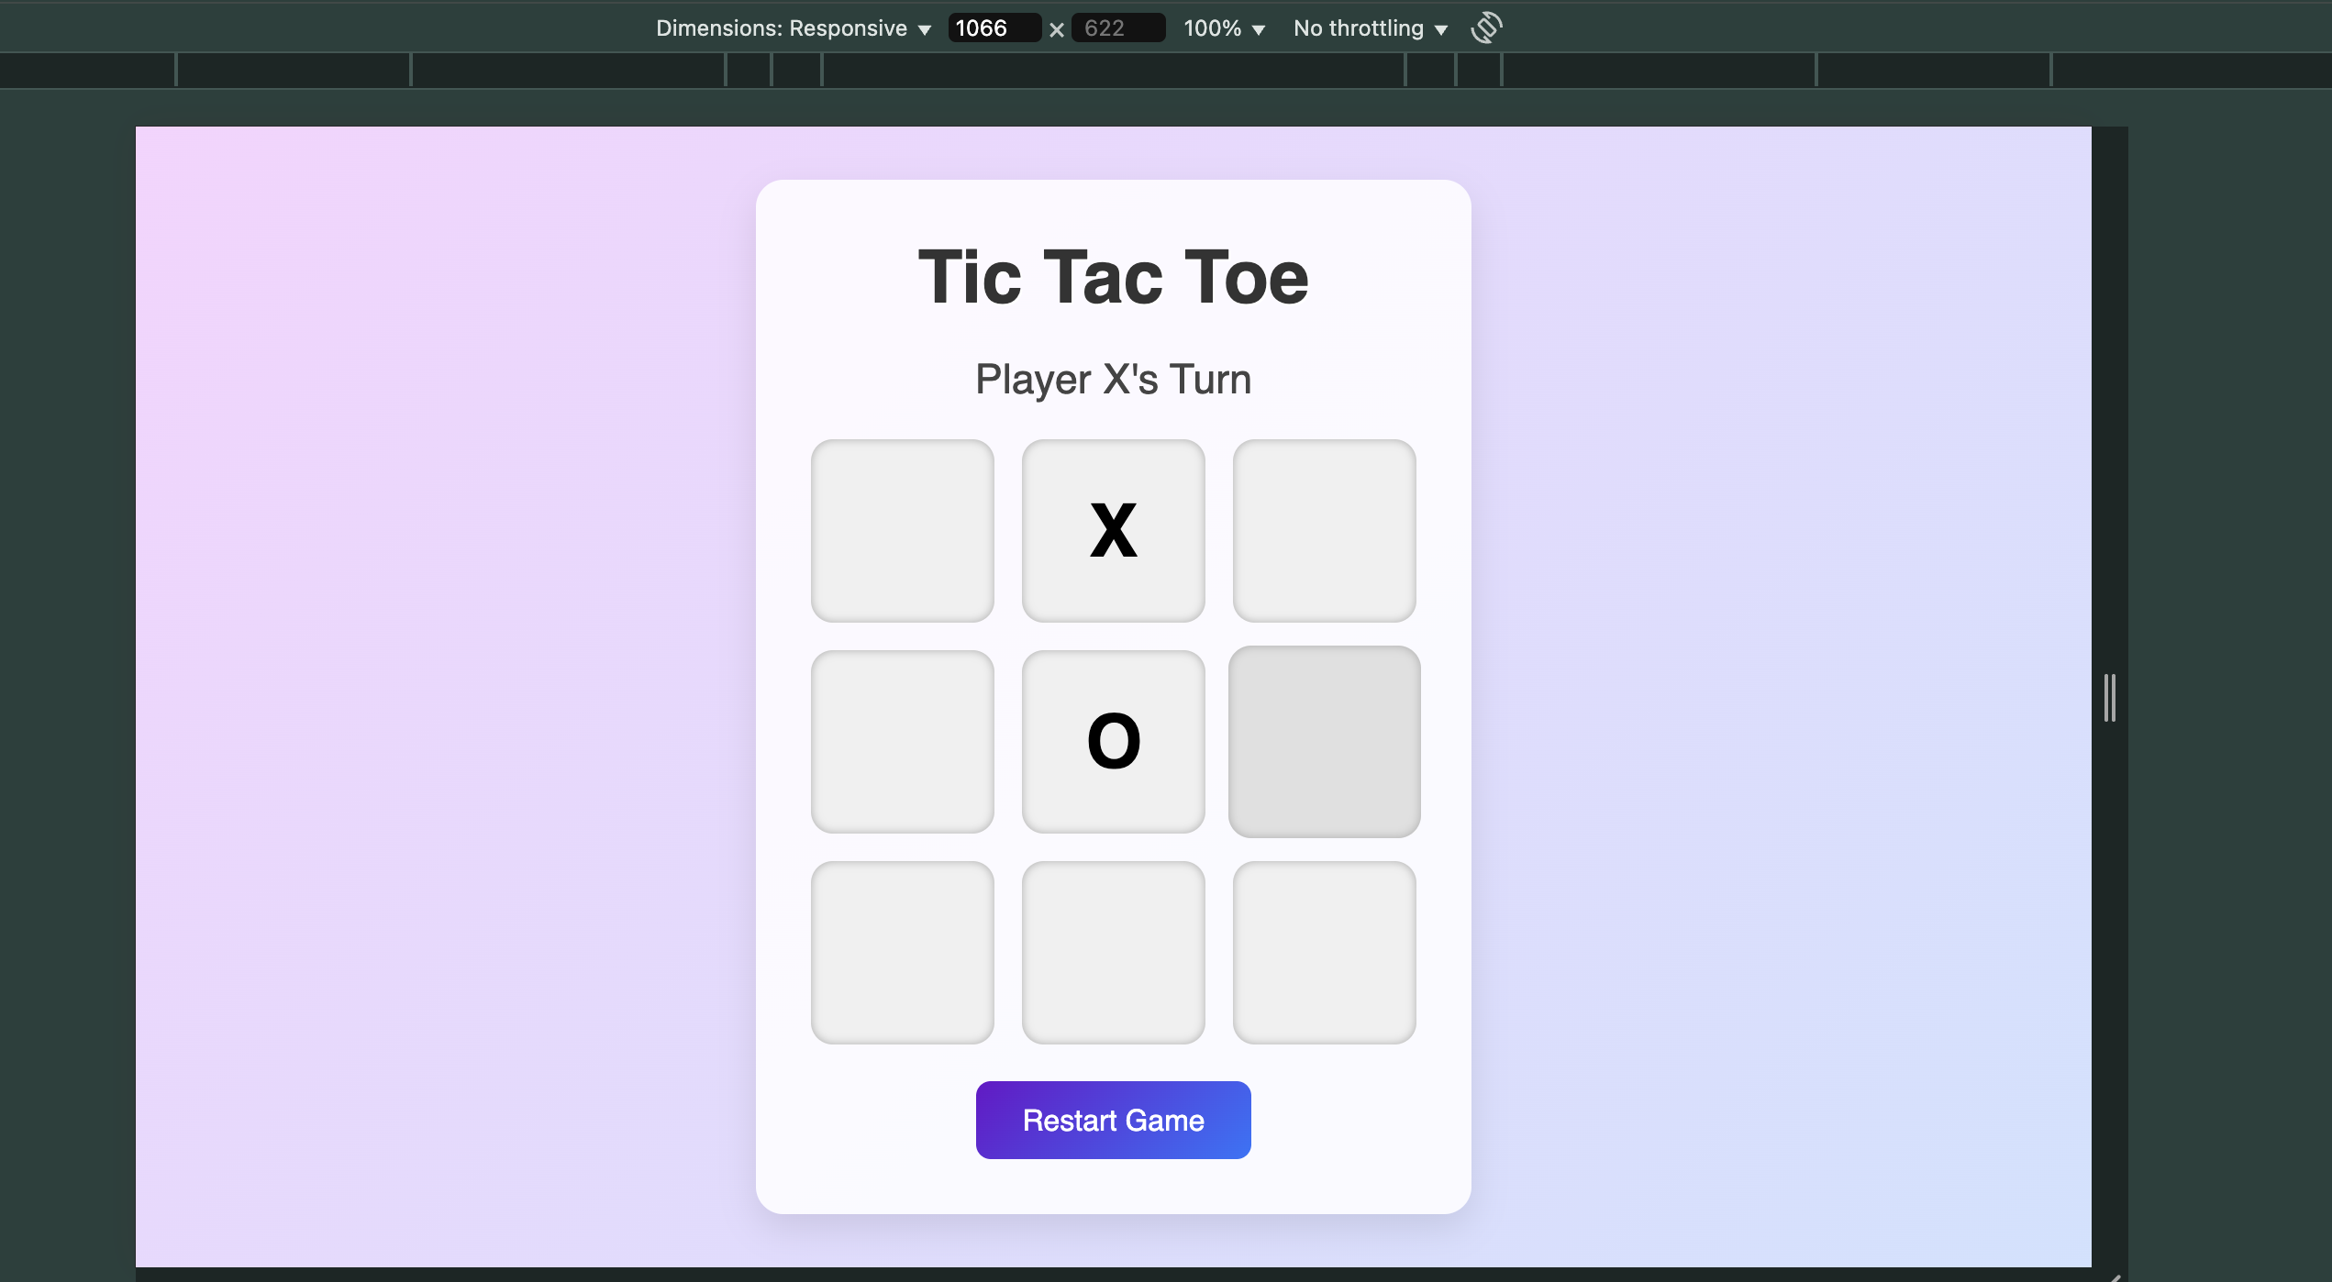
Features Summary
Interactive 2-player gameplay
Visual distinction between X and O
Responsive design for mobile
Restart functionality
Simple, clean UI
For Mobile Users
For Bigger screens

Slide 8
Future Enhancements
Add score tracking
Implement AI opponent
Add animations or sound effects
Save game state in local storage

